Slide 1
Credit Card Fraud Detection
Submitted By:
Devika Jayasri
Priyanka Swain
Ritika Ranjan

Slide 2
AGENDA
Objective
Background
Problem-Solving Approach
Key Insights
Cost Benefit Analysis
Appendix:-
Data Attributes
Data Methodology
Attached Files

Slide 3
OBJECTIVE
As part of the analytics team focused on fraud detection, our goal is to develop a machine learning model to identify fraudulent transactions based on historical customer transaction data.
We aim to assess the business impact of these fraudulent activities and provide recommendations on the most effective strategies for the bank to mitigate fraud risks. Implementing proactive monitoring and robust fraud prevention mechanisms will be crucial.
By leveraging machine learning, we can help the institution significantly reduce time-consuming manual reviews, minimize costly chargebacks and fees, and prevent the denial of legitimate transactions.

Slide 4
Background
The rise in fraudulent transactions has become a significant challenge for credit card companies, putting banks at risk of losing highly profitable customers. Banking fraud not only leads to substantial financial losses but also erodes trust and credibility, making it a critical concern for both banks and customers.
As digital payment channels continue to expand, the complexity and frequency of fraudulent activities are increasing. Fraudsters are constantly innovating new methods to exploit vulnerabilities, making fraud detection more challenging than ever.
To combat this growing issue, we conducted a root cause analysis of the rising fraud cases and the associated revenue losses. This analysis highlighted the urgent need for an advanced fraud detection system powered by machine learning techniques. Such a system is crucial for accurately identifying fraudulent activities in real time and preventing them from causing further harm.

Slide 5
Problem-Solving Approach
Reading and Understanding the Data ﻿﻿
Data Inspection
EDA (Univariate and Bivariate analysis)
﻿﻿﻿Data Preparation (Train/Test Data Splitting) ﻿﻿﻿
Multiple Model Building or Hyperparameter Tuning ﻿﻿﻿
Model Evaluation ﻿﻿﻿
Business Impact: - Cost Benefit Analysis (Before and After Model deployment)

Slide 6
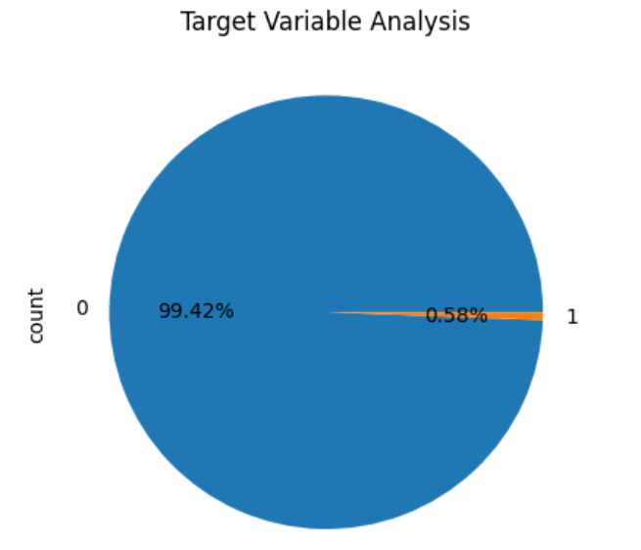

Key Insights
The dataset is highly imbalanced, with fraudulent transactions making up a small fraction:
Training Set: 0.58% fraud (7,506 out of 1,296,675)
Testing Set: 0.39% fraud (2,145 out of 555,719)
Non-fraudulent transactions dominate the dataset, representing over 99% of the total in both sets.

Slide 7
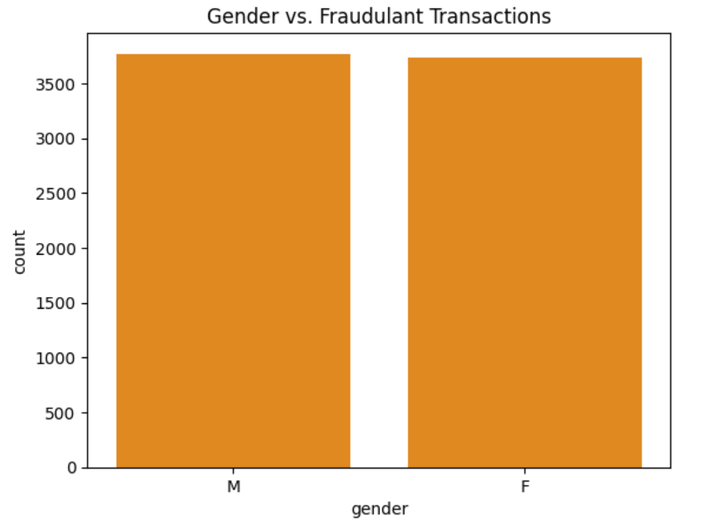
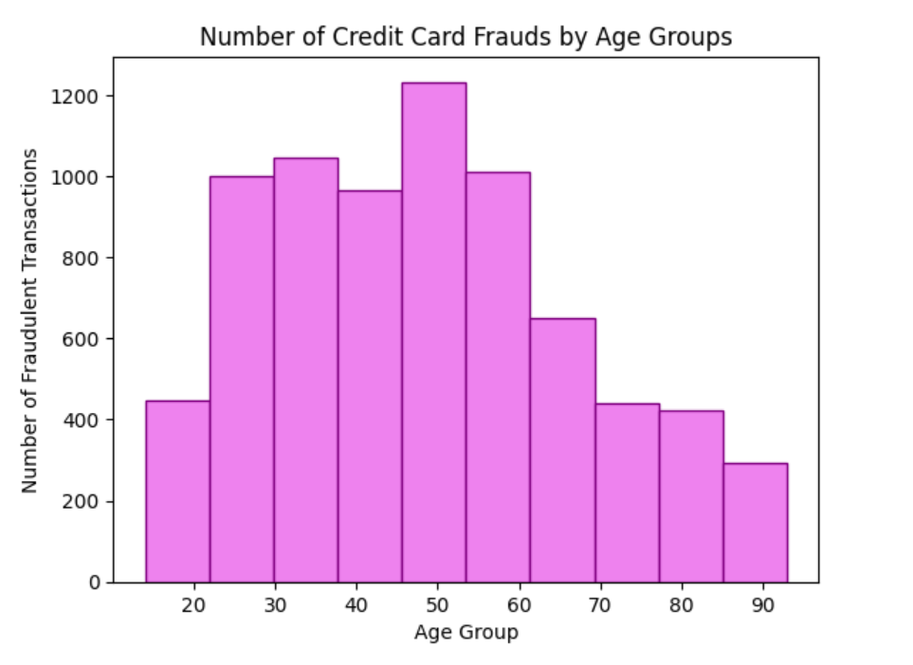
The distribution of fraudulent transactions is roughly equal between males and females, indicating no significant gender difference in the occurrence of fraudulent transactions.
Credit card fraud is most prevalent among individuals aged 30 to 50, with a noticeable decline in fraud cases among older age groups.

Slide 8
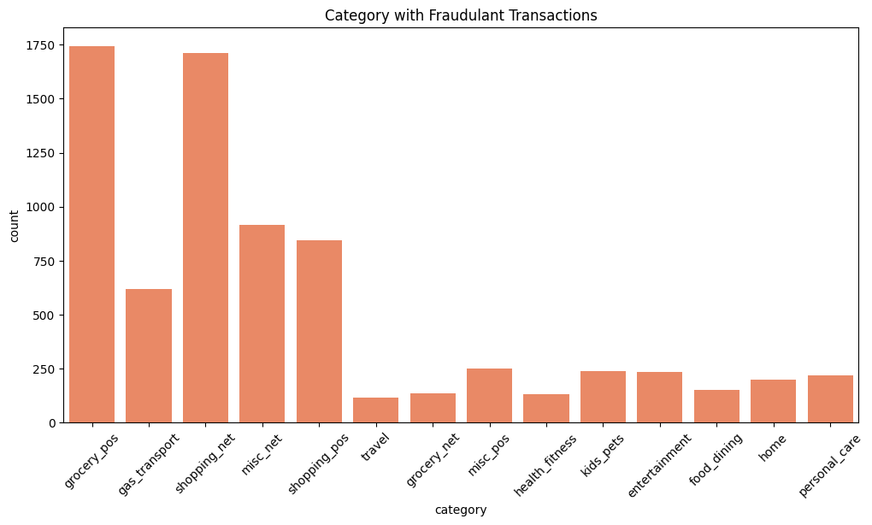
Fraudulent transactions are most common in categories related to grocery stores, online shopping, and miscellaneous internet purchases, indicating these areas are prime targets for fraudulent activities.

Slide 9
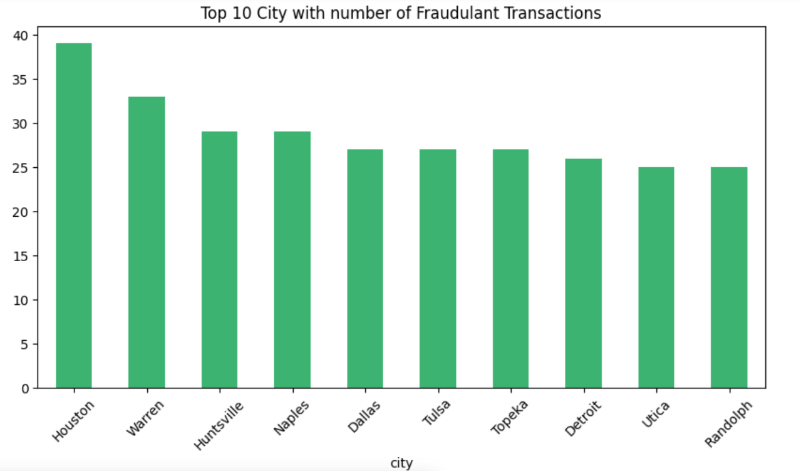
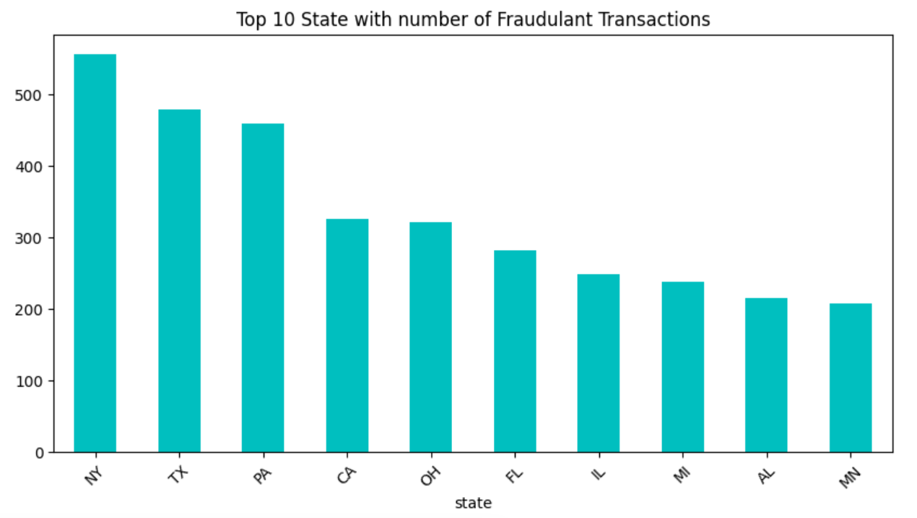
Houston leads the list, followed by Warren and Huntsville, indicating that these cities may have higher fraud risks.
New York, Texas, and Pennsylvania have the highest number of fraudulent transactions

Slide 10
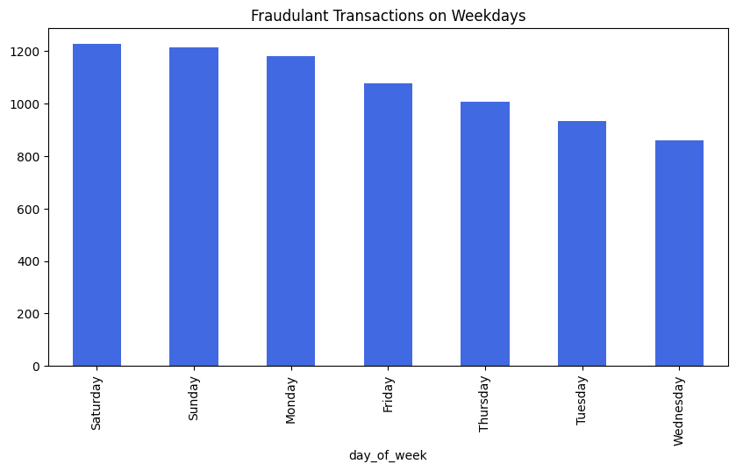
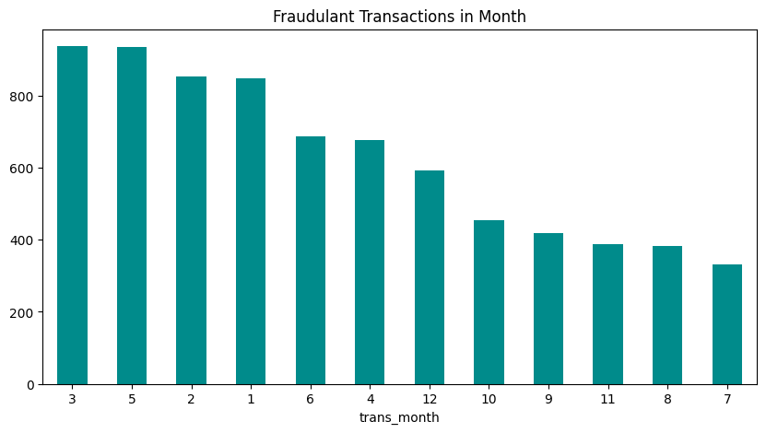
Fraudulent transactions peak on weekends, particularly on Saturday and Sunday, with the numbers gradually decreasing towards Wednesday, which has the fewest incidents. This suggests that fraudsters may be more active on weekends than during the weekdays.
The highest occurrences of fraudulent transactions are in March and May, with a steady decline in fraudulent activities from June through July. This pattern suggests certain months may be more prone to fraud, potentially due to seasonal factors or specific events.

Slide 11
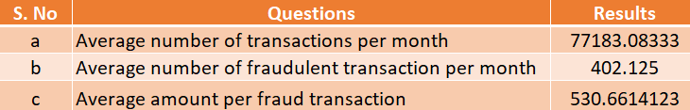
Cost Benefit Analysis
Part 1: Analysis of the the dataset and finding the following figures

Slide 12
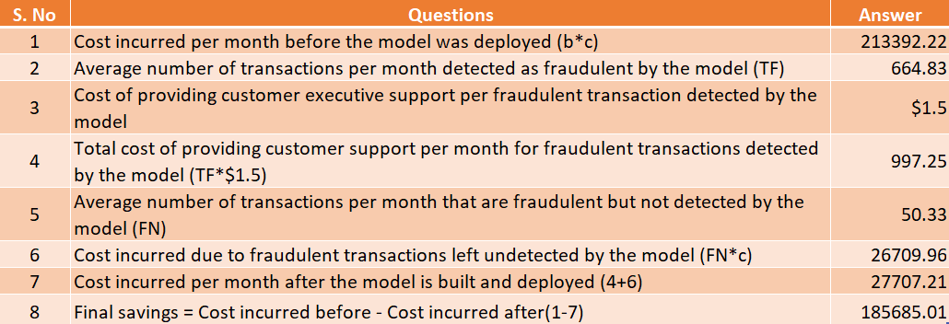
Part 2: Comparison of the cost incurred per month by the bank before and after the model deployment
Reduction in loss by ~87%

Slide 13
Appendix: Data Attributes
index - Unique Identifier for each row
trans_date_trans_time - Transaction DateTime
cc_num - Credit Card Number of Customer
merchant - Merchant Name
category - Category of Merchant
amt - Amount of Transaction
first - First Name of Credit Card Holder
last - Last Name of Credit Card Holder
gender - Gender of Credit Card Holder
street - Street Address of Credit Card Holder
city - City of Credit Card Holder
state - State of Credit Card Holder
zip - Zip of Credit Card Holder
lat - Latitude Location of Credit Card Holder
long - Longitude Location of Credit Card Holder
city_pop - Credit Card Holder's City Population
job - Job of Credit Card Holder
dob - Date of Birth of Credit Card Holder
trans_num - Transaction Number
unix_time - UNIX Time of transaction
merch_lat - Latitude Location of Merchant
merch_long - Longitude Location of Merchant
is_fraud - Fraud Flag <--- Target Class

Slide 14
Appendix: Data Methodology
The modeling process began with a Logistic Regression classifier, followed by a Decision Tree model, and ultimately a Random Forest classifier using a Kaggle simulated dataset.
Class imbalance was addressed using the Adaptive Synthetic (ADASYN) sampling method.
Manual hyperparameter tuning was employed due to the extensive computational time required for Grid Search Cross Validation.

Slide 15
Appendix: Attached Files
Cost Benefit Analysis:
Cost Benefit Analysis
Multiple ML model deployement:
CC Fraud Analytics Capstone.ipynb
Video Submission Link:

Slide 16
Thank You

